Slide 1





A beautiful sunset doing things that don’t matter. . .

Slide 2






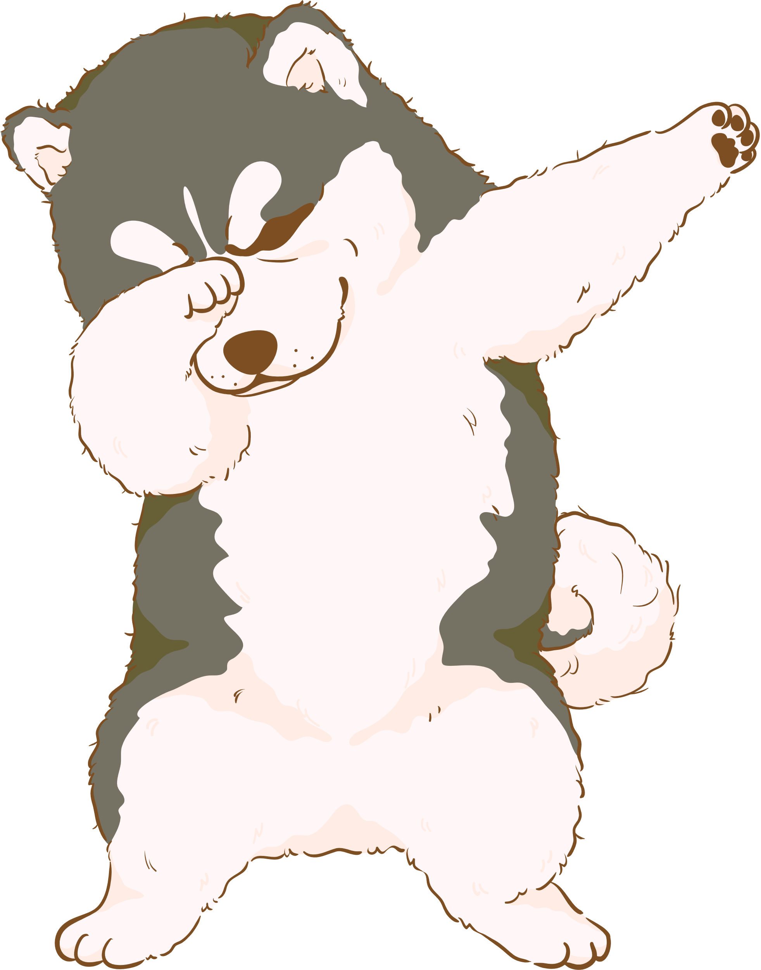


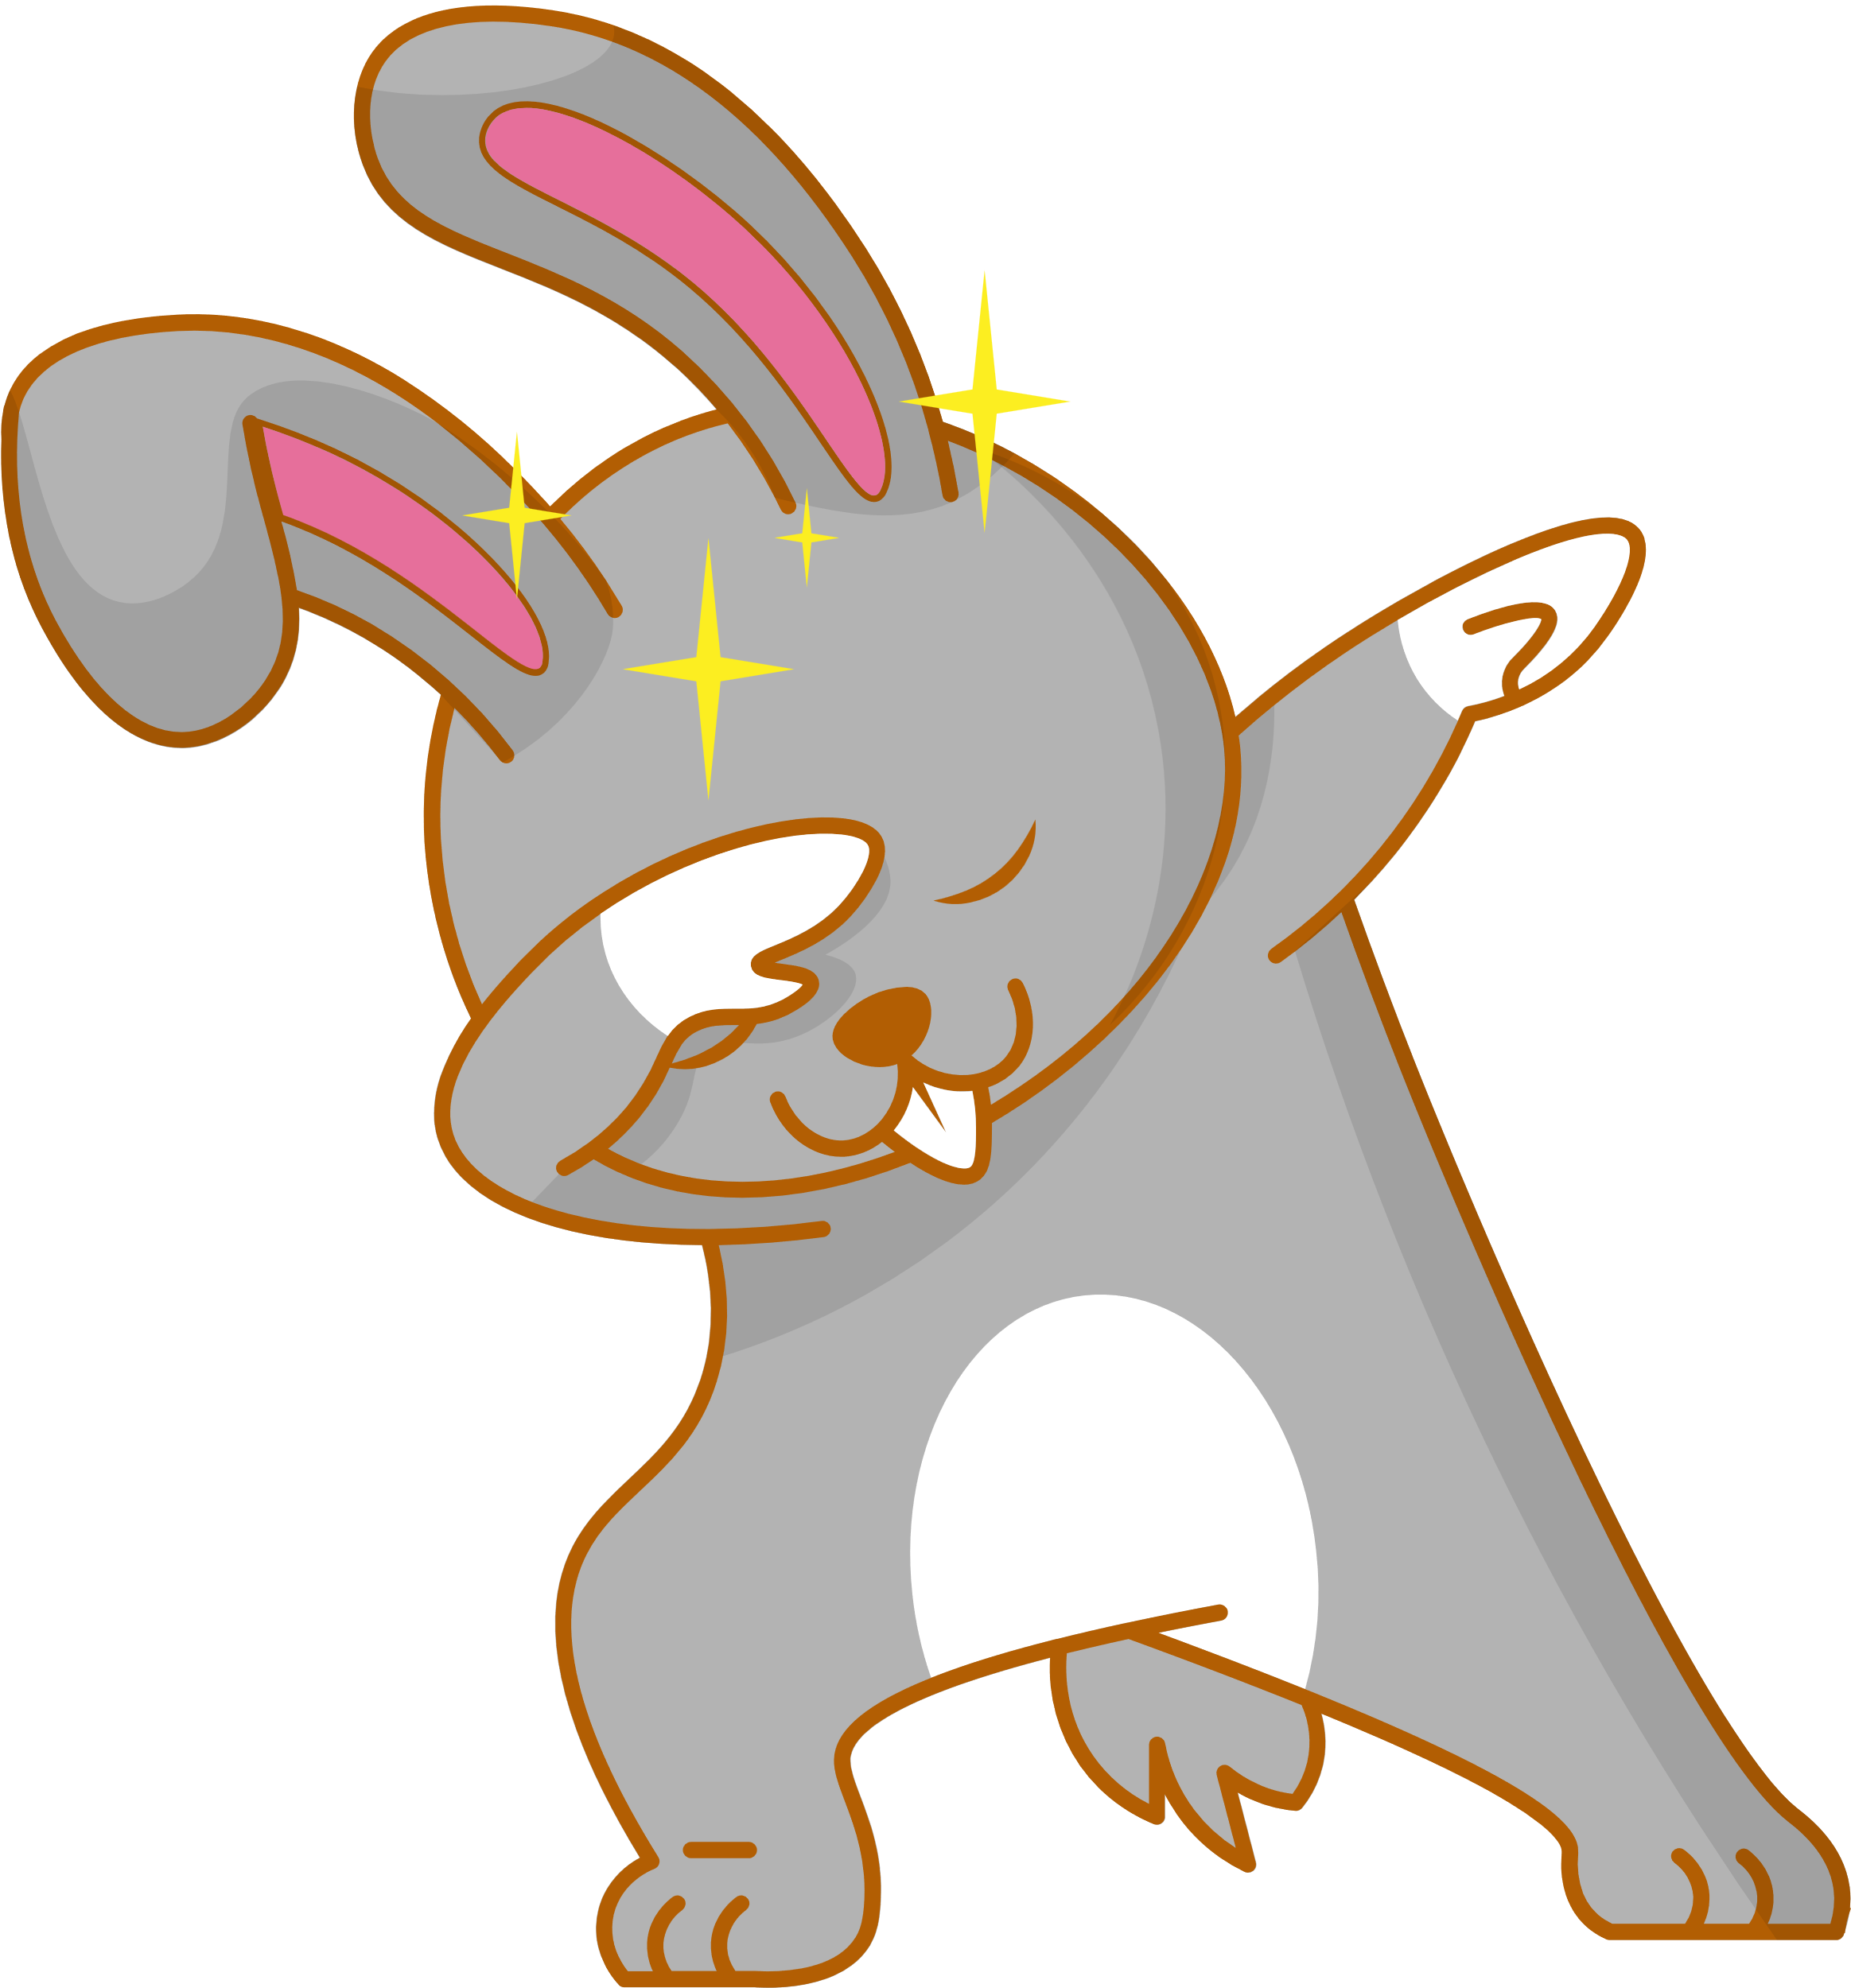
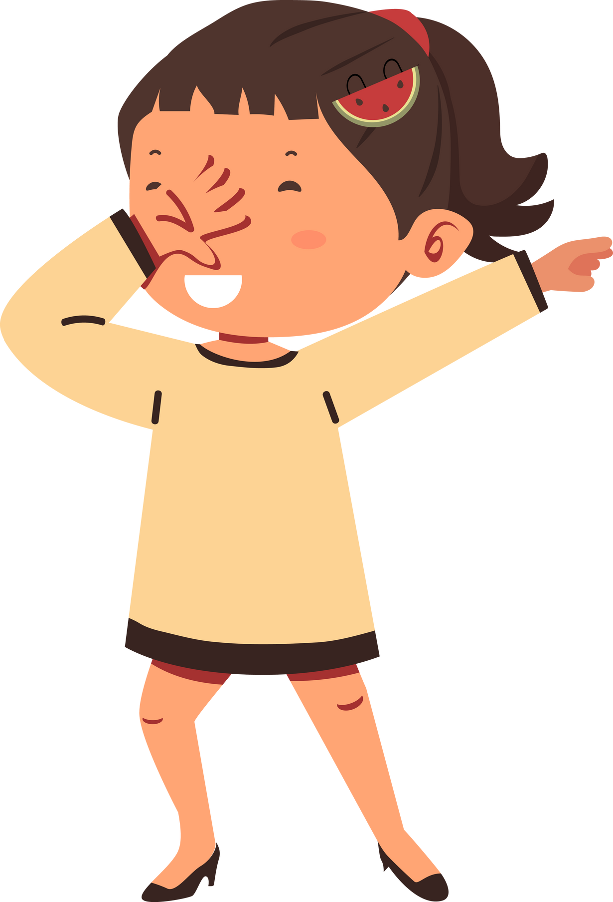



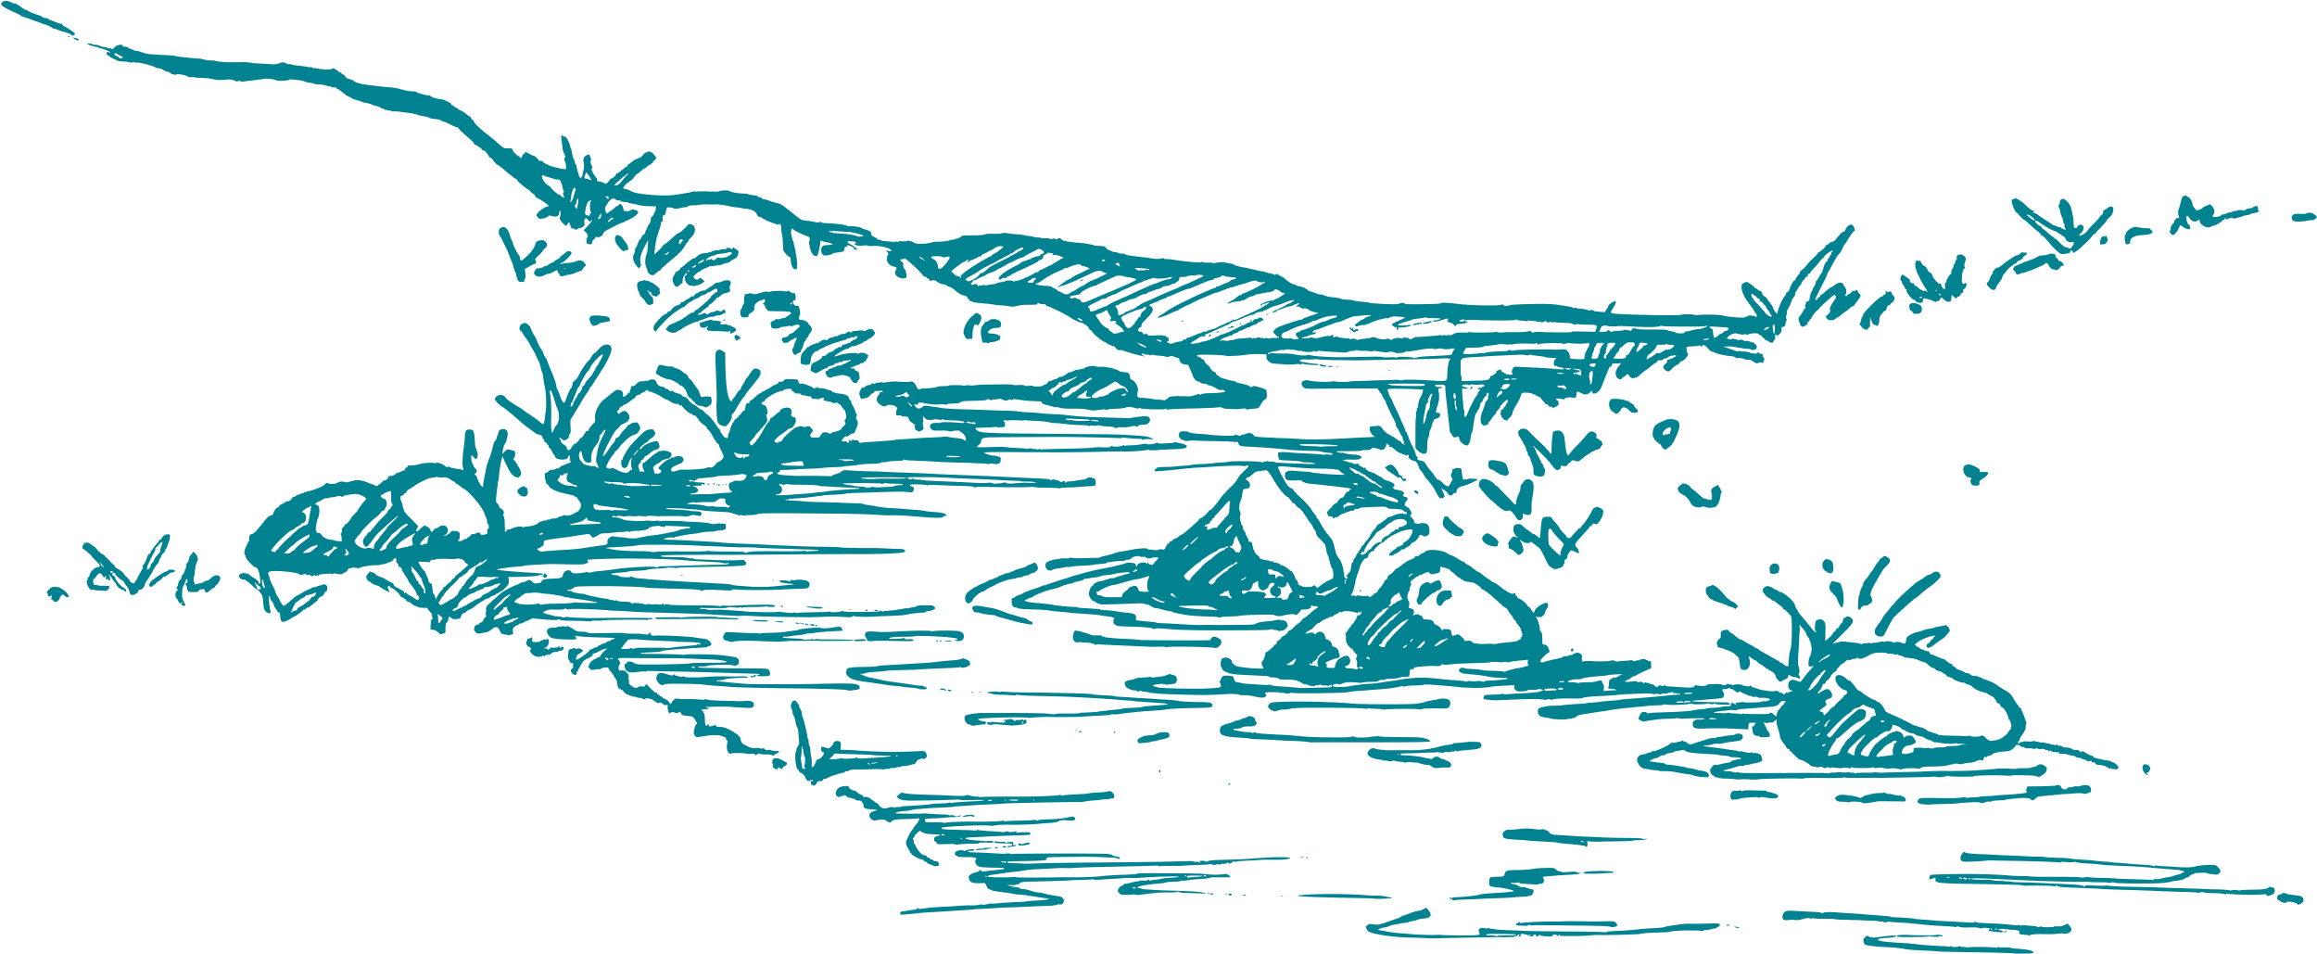
Drag and drop the elements of your choice on the table.
Choose Your Animal

Slide 3






A girl blowing bubbles against a backdrop of a beautiful sunset.

Slide 4
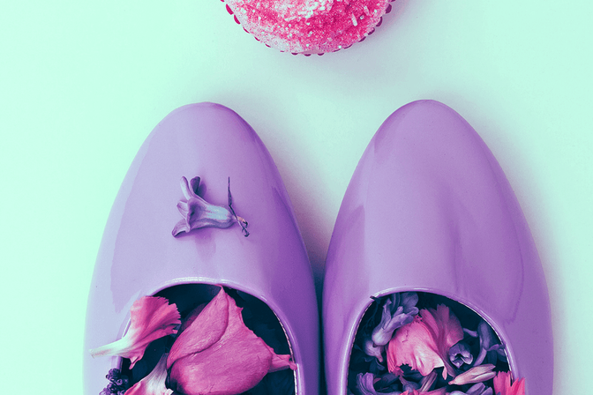
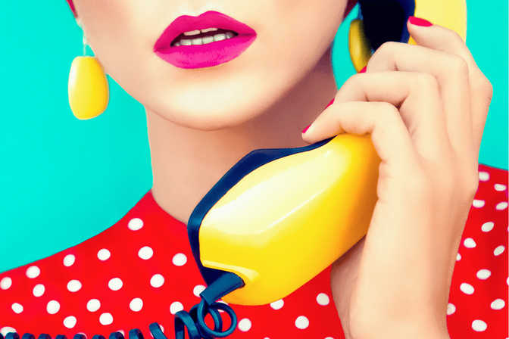
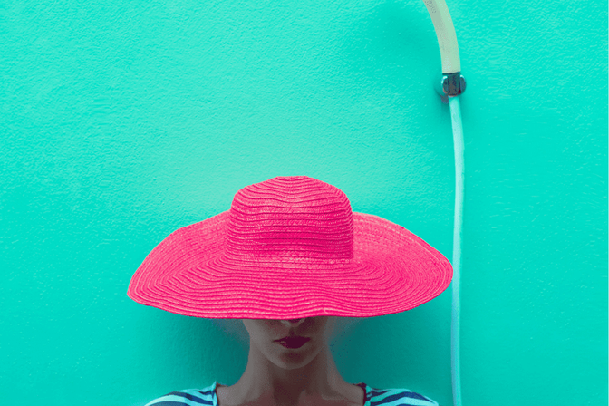
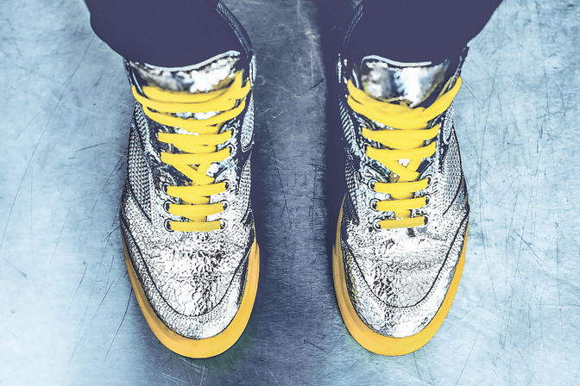
A girl blowing bubbles against a backdrop of a beautiful sunset.

Slide 5

A girl blowing bubbles against a backdrop of a beautiful sunset.

Slide 6
